Slide 1

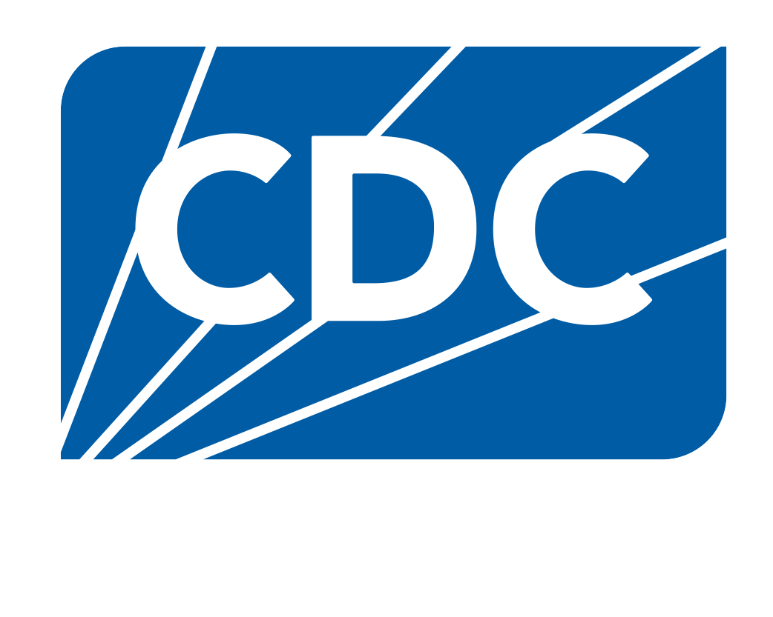
Urgent. Related. Preventable.
Adverse childhood experiences (ACEs), overdose and suicide are urgent, related and preventable public health challenges that have consequences for all of us.

Slide 2


ACEs, overdose and suicide are urgent, related and preventable public health challenges.

Slide 3
While these challenges impact all of us, some communities are more affected than others.

Slide 4

ACEs, overdose and suicide are urgent public health challenges.

Slide 5
Urgent Public Health Threat
Exposure to adversity and trauma before the age of 18, overdose and suicide contribute to shortened life span, rising health care costs, lost economic productivity and strain on our social service system that affect all of us.
This urgency is heightened by trauma passed down from one generation to another and by lack of public investment in some communities. This makes existing health challenges worse and makes it harder to seek preventative or lifesaving resources.

Slide 6

Understanding ACEs
Adverse childhood experiences (ACEs) are potentially traumatic events that occur in childhood.
ACEs can include neglect, experiencing or witnessing violence, and having a family member attempt or die by suicide.
Children of different races and ethnicities do not experience ACEs equally.
Notes:
ACEs are potentially traumatic events that happen in childhood, such as experiencing violence, abuse, or neglect; or witnessing violence in the home or community. ​

Slide 7
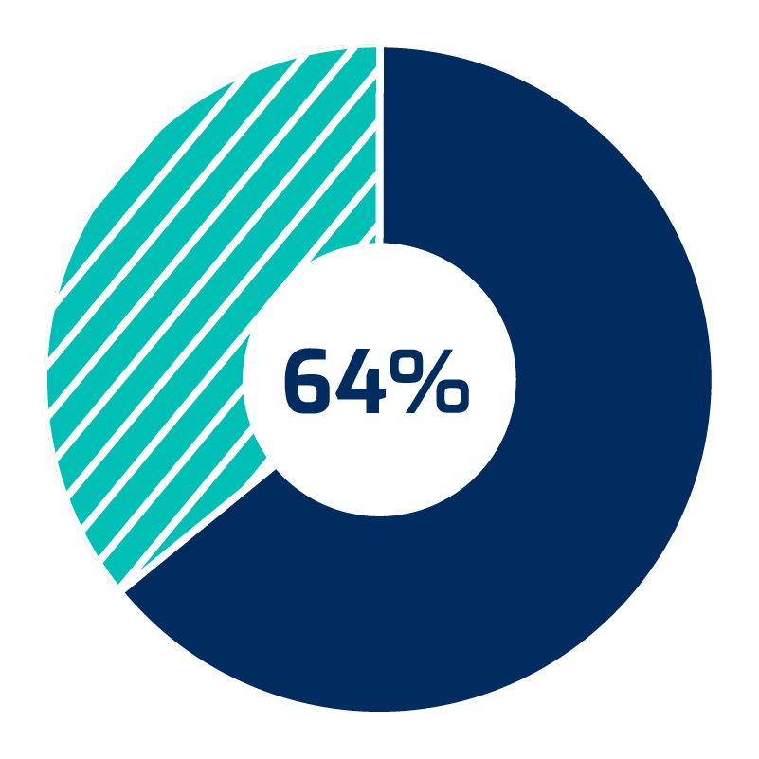


The Statistics of ACEs
% of Adults Reporting Experiencing 1 or More ACE
Asian
White
Hispanic or Latino
NH/OPI
Black
AI/AN
Multiracial
64% of adults
have experienced
at least one ACE.
1 in 6 adults have experienced four or more types of ACEs.
ACEs are related to at least 7 of the leading causes of death.
ACEs affect some racial/ethnic groups more than others.
Notes:
Adverse childhood experiences are an urgent public health issue. Research has shown that 64% of adults have experienced at least one ACE and 1 in 6 adults have experienced four or more types of ACEs. The impact of ACEs on health is vast. At least 7 of the top 10 leading causes of deaths in the United States are associated with ACEs.
•Multiracial: 77.1%
•AI/AN: 74.6%
•Black: 70.1%
•NH/OPI: 66.7%
•Hispanic or Latino: 65.1%
•White: 62.9%
•Asian: 50.2%
WISQARS Leading Causes of Death Visualization Tool (cdc.gov)
ACEs are related to at least 7 of the leading causes of death. ACEs are related to heart disease, malignant neoplasms (i.e., cancer), unintentional and other injury, cerebrovascular conditions (includes stroke), chronic lower respiratory disease (this includes asthma), diabetes, and nephritis (i.e., kidney disease). The classifications are slightly different because the BRFSS paper is pulled from survey data and WISQARS leading causes of death are pulled from ICD-10 categories/codes.

Slide 8




ACEs Impacts
ACEs can negatively impact development.
physical
emotional
mental
behavioral
ACEs can also have lasting effects on health, well-being and prosperity far into adulthood.
Notes:
ACEs can have effects that are seen throughout life - increasing the possibility of everything from depression and suicide, infectious and chronic diseases and risky behaviors.

Slide 9
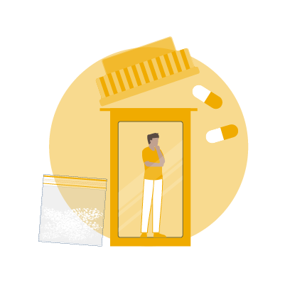
Understanding Overdose
Drug overdose is the poisoning that happens when a drug is taken in excessive amounts.
An overdose can be fatal or nonfatal, and all overdoses come with their own emotional and economic toll.
Overdose deaths impact some communities more than others.
Notes:
Next, I’d like to bridge to overdose. Drug overdose is a poisoning that happens when a drug is taken in excessive amounts. An overdose can be fatal or nonfatal and all overdoses come with their own emotional and economic tolls.

Slide 10
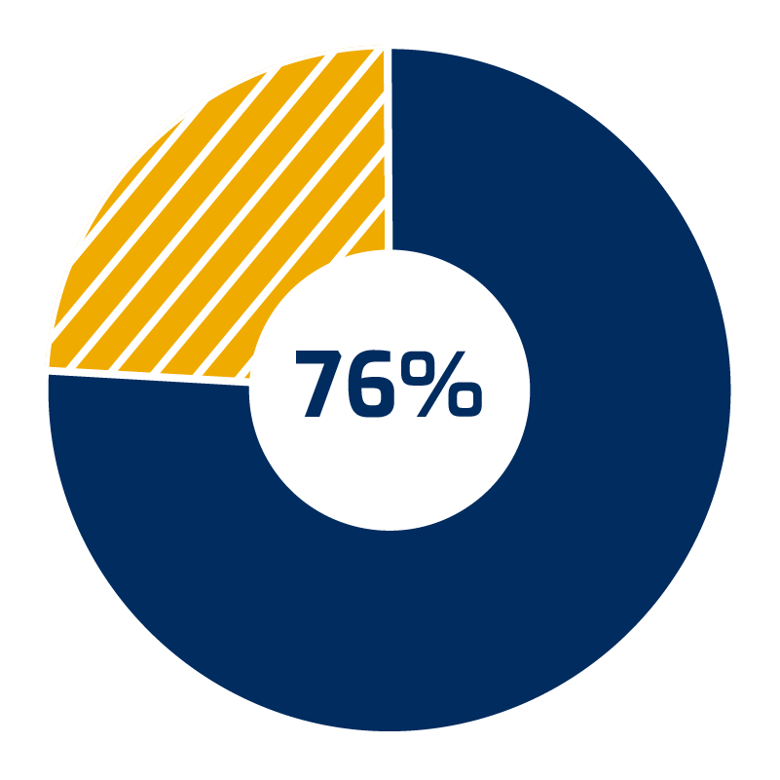
The Statistics of Overdose
From 2021-2022
Opioids were involved in over
In 2022
More than
1 MILLION
107,941
people have died since 1999 from a drug overdose.
drug overdose deaths occurred in the United States.
of overdose deaths in 2022.
the annual increase in drug overdose deaths differed by race/ethnicity.
Notes:
6/21/2024 CS: updated 76% in 2022, total deaths number, can update graphic using https://www.cdc.gov/nchs/data/databriefs/db491.pdf
AIAN increased 15%, Black increased 7.5%, Hispanic increased 7.6%
NOTE SOURCE: From 2019 to 2020, the annual increase in drug overdose deaths was 56% among Black and 41% among Hispanic, but was 28% among White persons. (https://www.cdc.gov/mmwr/volumes/71/wr/mm7146a4.htm#:~:text=From%202019%20to%202020%2C%20all,by%20Black%20and%20Hispanic%20persons)
The devastating toll of overdose deaths continues to rise. (read stats above)
"From 2020 to 2021, non-Hispanic Native Hawaiian or Other Pacific Islander and non-Hispanic American Indian or Alaska Native people experienced the largest percentage increases in drug overdose death rates from 2020 through 2021, with rates increasing 47% and 33%, respectively, followed by a 23% increase among non-Hispanic Black and 20% increase among Hispanic persons."

Slide 11
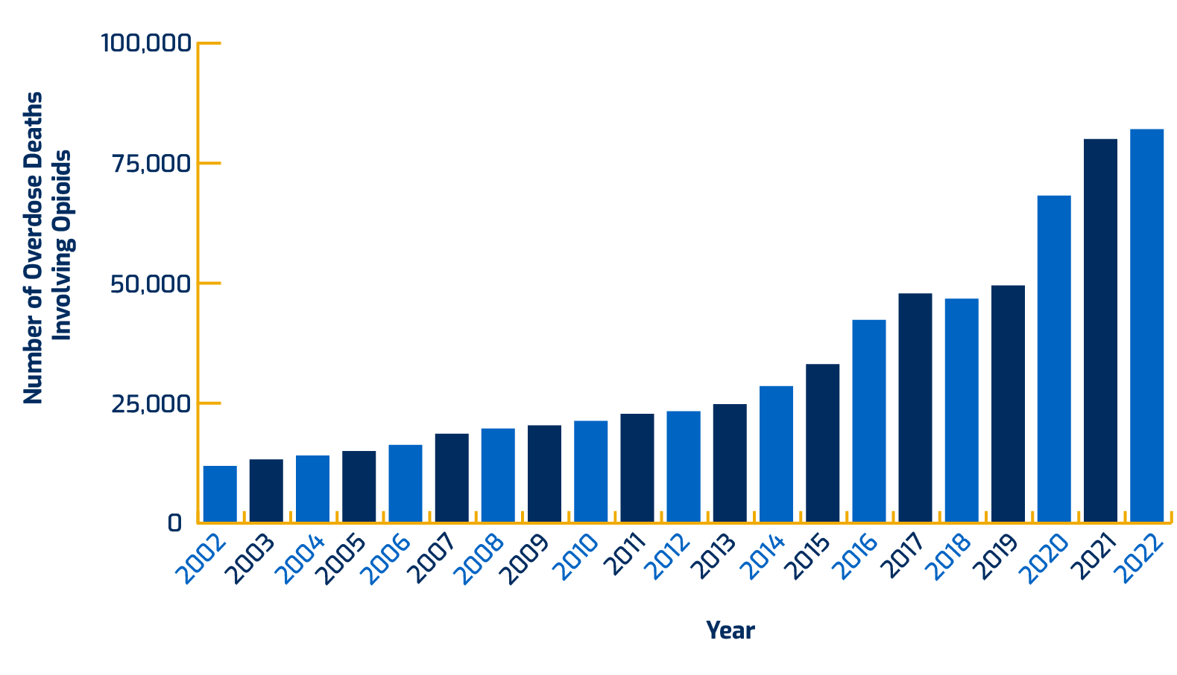
Overdose Over Time
Overdose deaths involving opioids, including prescription opioids, heroin and synthetic opioids (like fentanyl), have increased about eight times since 2002.
Number of Overdose Deaths Involving Opioids
From 2002–2022
Source: National Center for Health Statistics, National Vital Statistics System, Mortality

Slide 12
Understanding Suicide
Dying by suicide continues to be a leading cause of death in the United States.
Suicidal ideation and attempts are also on the rise.
Suicide rates vary by population.
Notes:
Finally, the urgency of addressing ACEs and overdose is compounded by the urgency of addressing suicide, which continues to be in the top ten leading causes of death in the United States.

Slide 13
The Statistics of Suicide
In 2022
OVER
49,000
13.2 million
people died by suicide
adults seriously thought about suicide
3.8 million
1 death every
11 minutes
made a plan
1.6 million
attempted suicide
Source: CDC Suicide Data and Statistics | Suicide Prevention | CDC
Notes:
Suicide is a leading cause of death in the United States, with 45,979 deaths in 2020. This is about one death every 11 minutes. The number of people who think about or attempt suicide is even higher. In 2020, 1.2 million attempted suicide, 3.2 million planned a suicide attempt, and an estimated 12.2 million American adults seriously thought about suicide.

Slide 14
Suicide Rates Vary by Population
Between 2018–2021, suicide rates significantly increased overall among non-Hispanic AI/AN (26%) and non-Hispanic Black (19.2%) people, and declined by 3.9% among non-Hispanic White people.
In addition, suicide risk is higher among
people who identify as lesbian, gay or bisexual.
Source: https://www.cdc.gov/suicide/facts/disparities-in-suicide.html
Notes:
NOTE SOURCE: Between 2018-2021, suicide rates significantly increased overall among non-Hispanic AI/AN (26%) and non-Hispanic Black (19.2%) people, and declined by 3.9% among non-Hispanic White people. In addition, Suicide risk is higher among people who identify as lesbian, gay, or bisexual. (https://www.cdc.gov/suicide/facts/disparities-in-suicide.html)

Slide 15

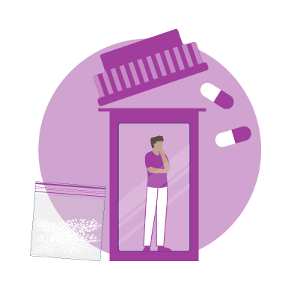


Exposure to Suicide
Exposure to…
Another person’s suicide
Substance use disorder
A family history of suicide
Suicidal ideation
… are risk factors that increase the possibility of suicide.

Slide 16
ACEs, overdose and suicide are related public health challenges.

Slide 17
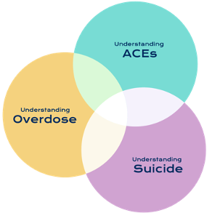
Related Issues
ACEs, suicide and overdose are related issues.
Exposure to ACEs increases the risk of overdose and suicide later in life.

Slide 18
ACEs and Overdose
ACEs are associated with younger age of initiation of opioid use, injection drug use, and lifetime overdose.
Source: Stein MD, Conti MT, Kenney S, et al. Adverse childhood experience effects on opioid use initiation, injection drug use, and overdose among persons with opioid use disorder. Drug Alcohol Depend. 2017;179:325-329. doi:10.1016/j.drugalcdep.2017.07.007
Notes:
Source: Stein MD, Conti MT, Kenney S, et al. Adverse childhood experience effects on opioid use initiation, injection drug use, and overdose among persons with opioid use disorder. Drug Alcohol Depend. 2017;179:325-329. doi:10.1016/j.drugalcdep.2017.07.007

Slide 19
Overdose and Suicide
Past year prescription opioid misuse is associated with an increase in the odds of suicidal ideation of 40% to 60%.
Source: https://pubmed.ncbi.nlm.nih.gov/28364579/
Notes:
Source: https://pubmed.ncbi.nlm.nih.gov/28364579/

Slide 20
ACEs and Suicide
Experiencing any ACE is associated with an increased risk for suicide; the odds of ever attempting suicide are more than 10 times higher for adults with four or more ACEs compared to adults with no ACEs.
Source: Hughes K, Bellis MA, Hardcastle KA, Sethi D, Butchart A, Mikton C, Jones L., Dunne MP. The effect of multiple adverse childhood experiences on health: a systematic review and meta-analysis. The Lancet; 2017;2:e356-66.
Notes:
Source: Hughes K, Bellis MA, Hardcastle KA, Sethi D, Butchart A, Mikton C, Jones L., Dunne MP. The effect of multiple adverse childhood experiences on health: a systematic review and meta-analysis. The Lancet; 2017;2:e356-66.

Slide 21
ACEs, Overdose and Suicide
ACEs are associated with increased risk of overdose and suicide later in life. For children, living with a parent with a mental health or substance use problem or losing a loved one to suicide or overdose is an ACE.
Experiencing these is associated with increased risk of future overdose or suicide, diminishing the fair and full opportunity to be healthy now and for generations to come.

Slide 22
ACEs, overdose and suicide are preventable public health challenges.

Slide 23



Prevention Strategies
Focus on prevention through system-level changes, public education, and implementation of policies and programs based on the best available evidence.
We need a coordinated approach to ensure equity in policies, programs and services.
Together, we can shrink the
impact of these three
interrelated issues.
Notes:
Fortunately, these three crises are preventable if we take a collaborative public health approach that addresses the complex and often related challenges that impact health. By building on community strengths—and focusing not just on treatment, but also on prevention—we can meet the immediate needs of those already affected while preventing future risk and negative health outcomes.

Slide 24

Using Collaborative Strategies
Successful approaches often require collaboration with other sectors to address these complex and related challenges appropriately.
Greater impact can happen when there is alignment between policy, funding and programs that address these three issues together, rather than some current efforts that focus on each issue individually.
Example Strategy
By creating policies based on the understanding that childhood trauma is
a risk factor for suicide and overdose, we can protect children today and prevent future risks.

Slide 25




Addressing Today’s Crises and Preventing Tomorrow’s
We need a coordinated approach to address health inequities contributing to disparities in exposure to ACEs, overdose and suicide:
Increase understanding of the causes and impact, and better coordinate across treatment and prevention fields.
Engage a broad movement of champions and change agents in communities.
Implement successful treatment and prevention strategies that are adapted for specific cultural contexts.
Invest in research and evaluation to better understand what works, why and for whom.

Slide 26
What Now?
You have the power to make a difference.
Find the Words: to educate others about the intersection of these urgent
public health issues.
Spread the Word: to generate awareness of these interrelated public
health issues.
Visit UrgentRelatedPreventable.org to learn more.
Notes:
So, we encourage you to take a look at these pages and find areas in your own work where you can begin building bridges and making connections.

